Slide 1
Employee Management System
Presented By:
Mohammad Arif
(AES Ensemble)
Presented To:
Vikash Verma

Slide 2
agenda
Introduction 3
Add Employee 4
List Employee 5
Delete Employee 6
Update Employee 7

Slide 3
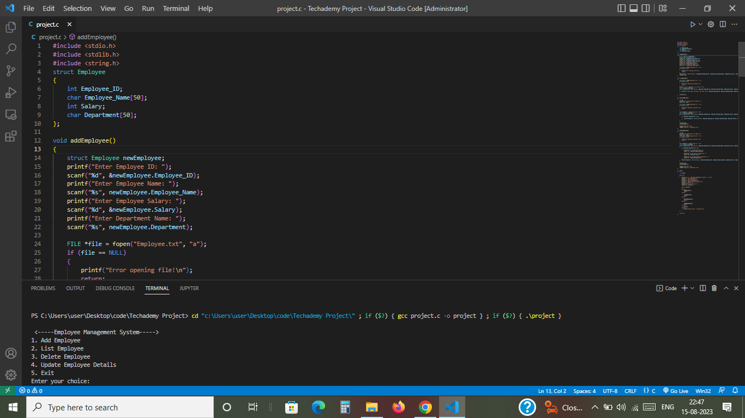
Introduction

Slide 4
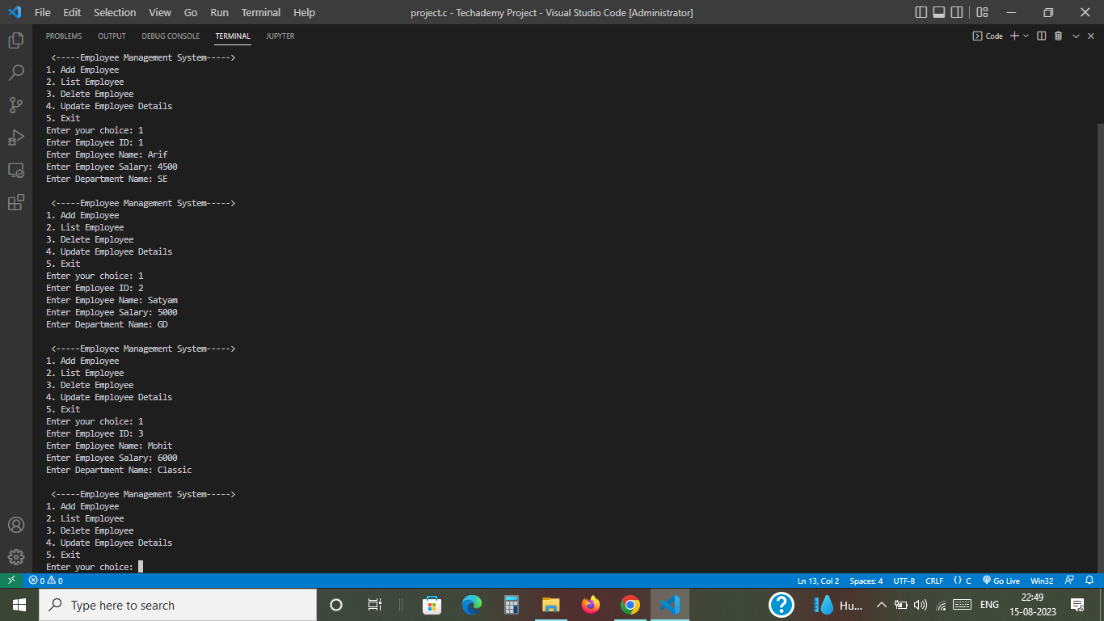
Add Employee

Slide 5

List Employee

Slide 6
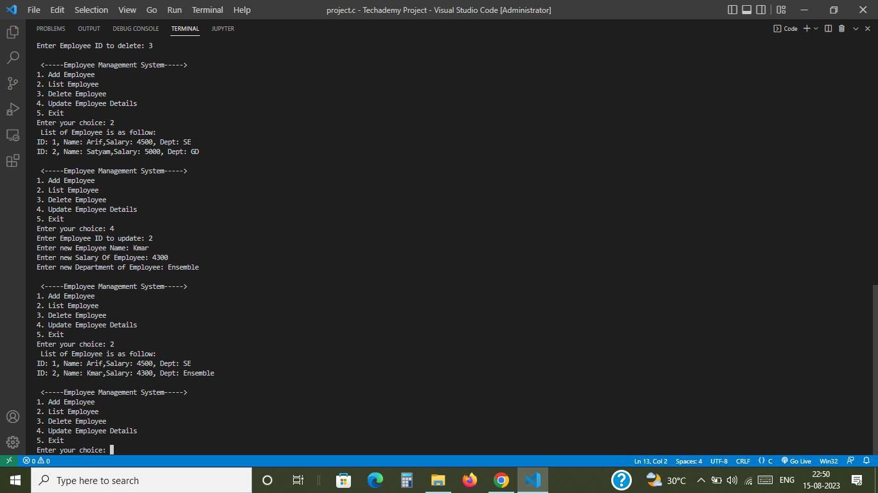
Delete Employee

Slide 7
Update Employee

Slide 8
thank you

